Slide 1

The Noise Complaints of New York City

Slide 2
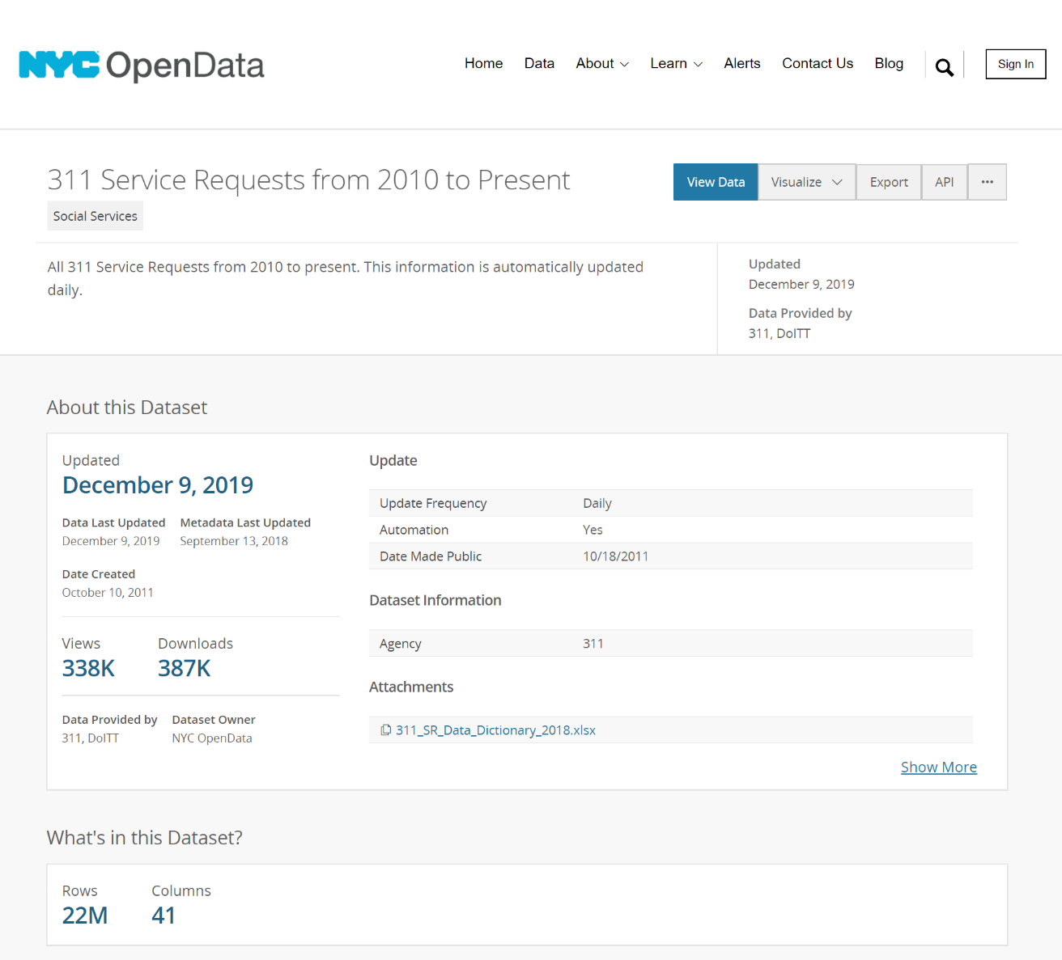
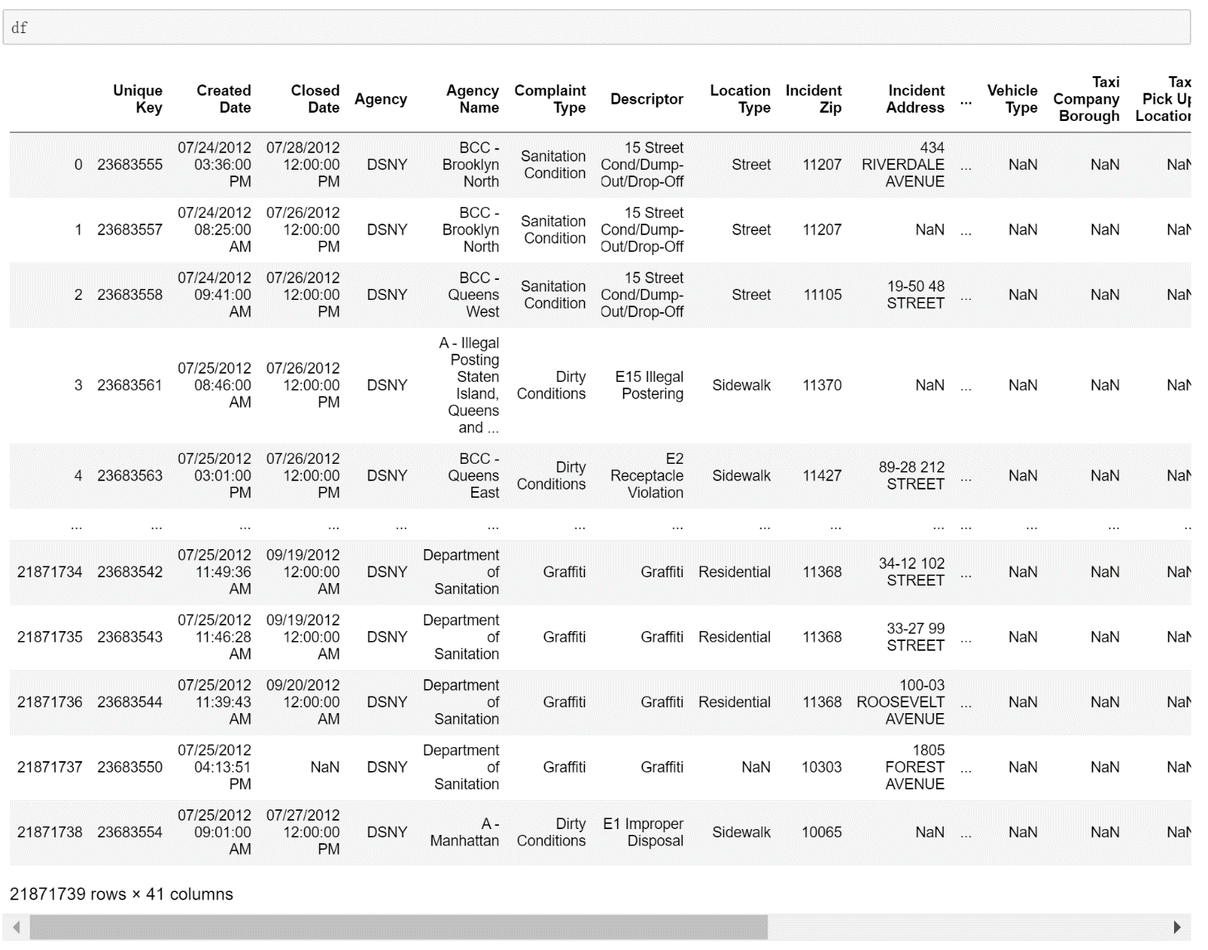
The NYC 311 Website
The Dataset in Python
https://nycopendata.socrata.com/Social-Services/311-Service-Requests-from-2010-to-Present/erm2-nwe9

Slide 3
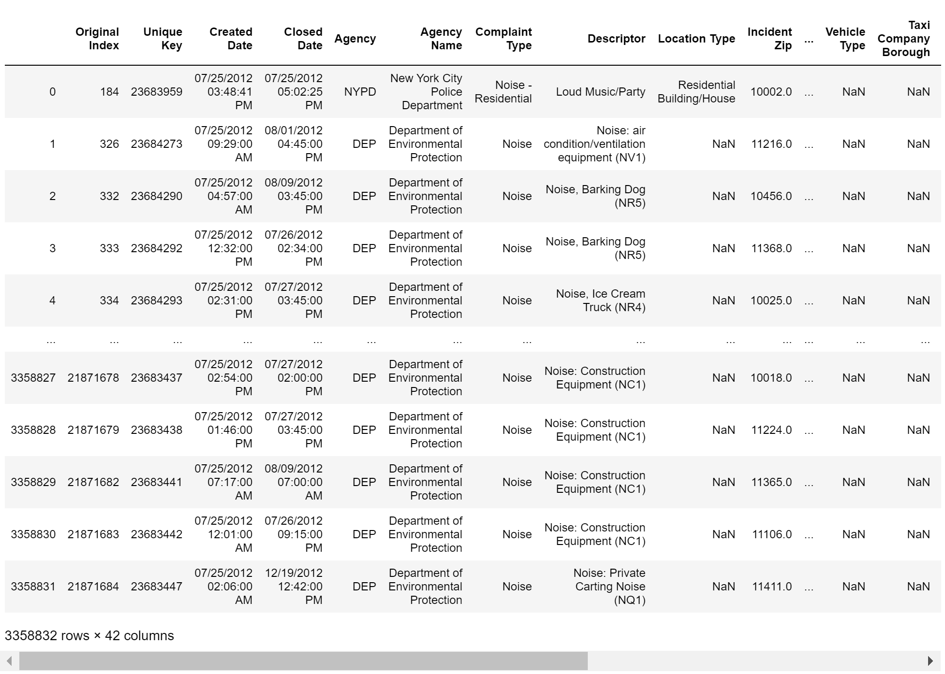
The NYC 311 Noise Data (3 Million)

Slide 4
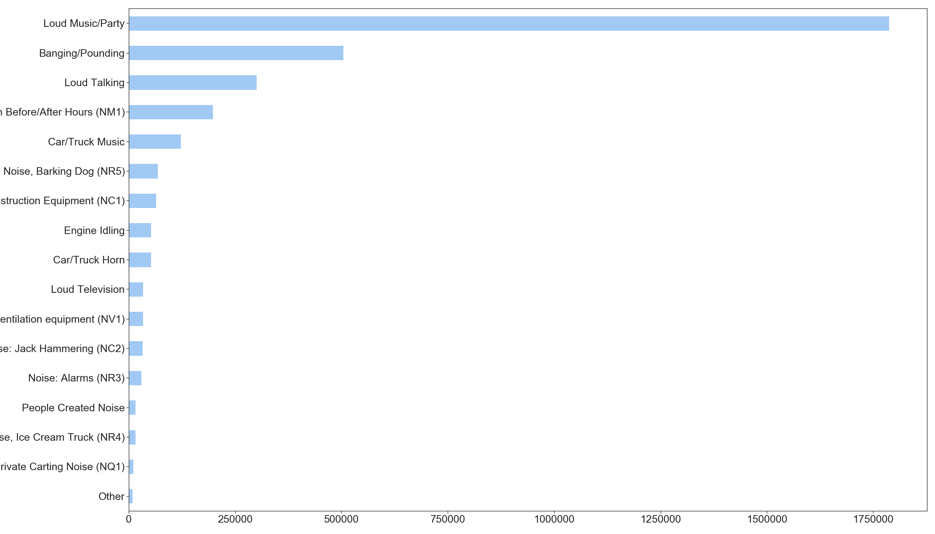
What’s the Noise About
More than half of the complaints are Loud Music/Party

Slide 5
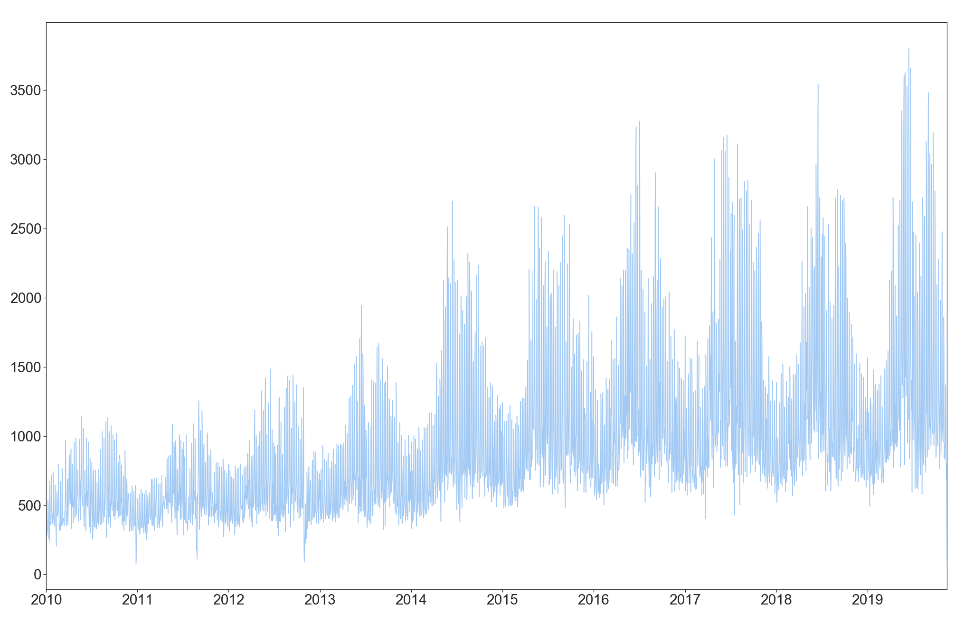
How the Noise Complaints Change
The complaints are Increasing.
But it’s hard to say this is because of the promotion of NYC 311 or there are more noise.

Slide 6
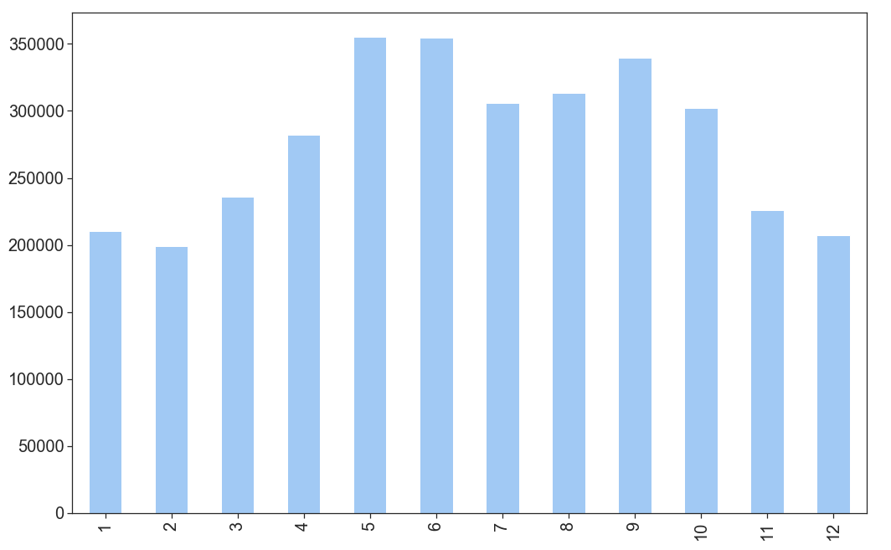
How the Noise Complaints Change
Most complaints are in
May & June

Slide 7
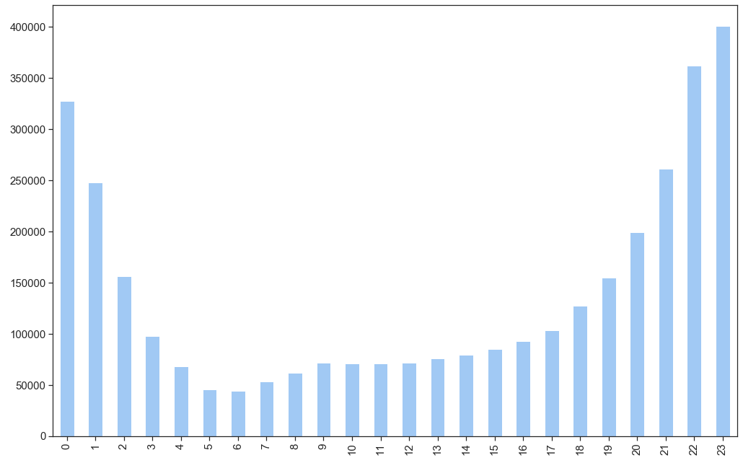
How the Noise Complaints Change
Most complaints are in
Night Sleep Time

Slide 8
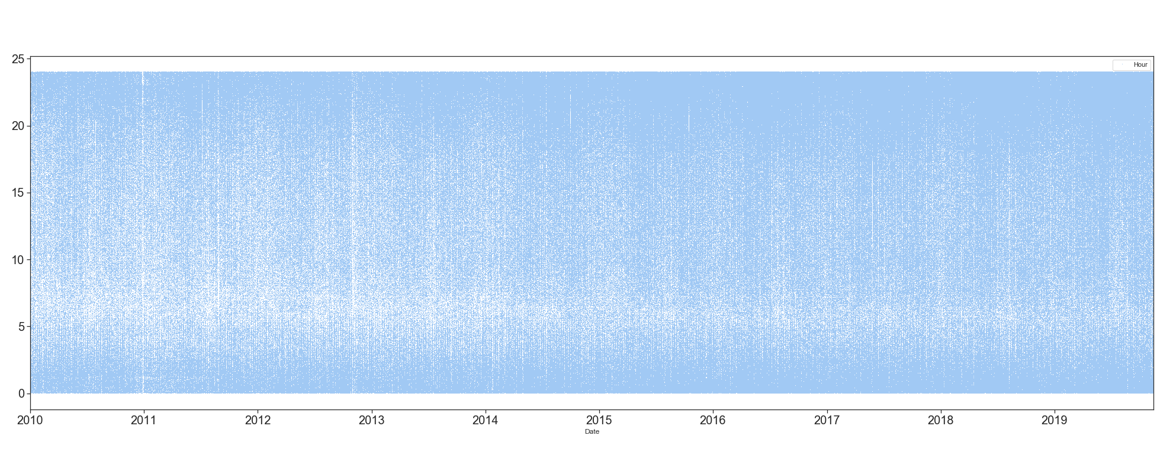
How the Noise Complaints Change

Slide 9
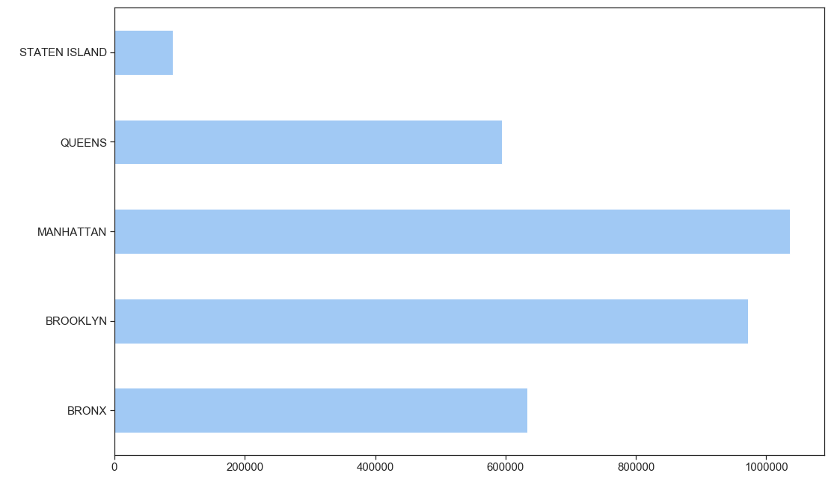
Where is Noisy

Slide 10
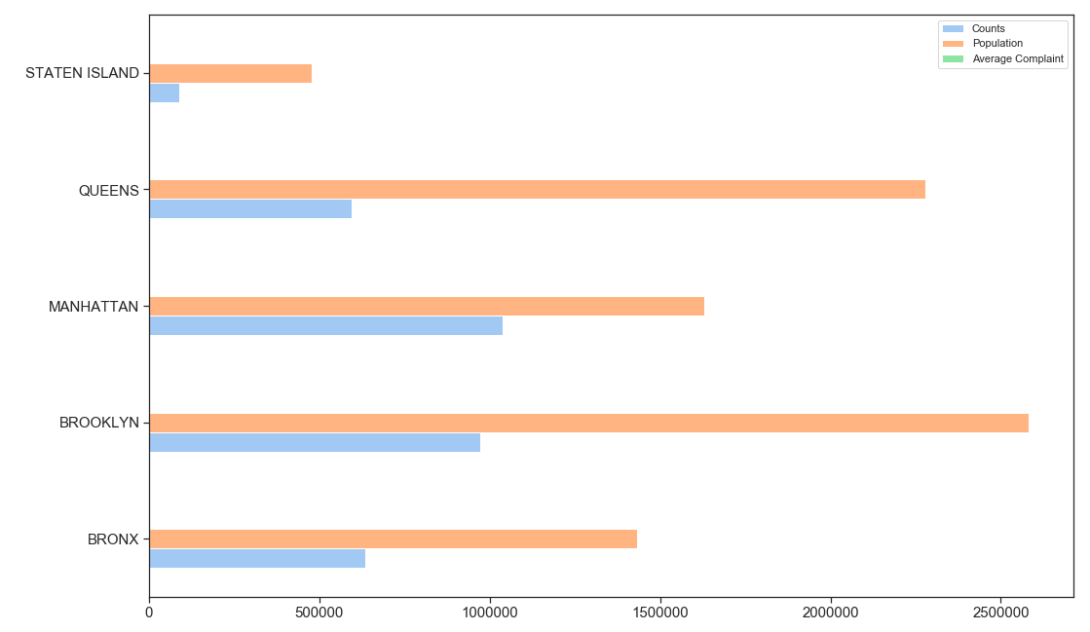
Where is Noisy

Slide 11
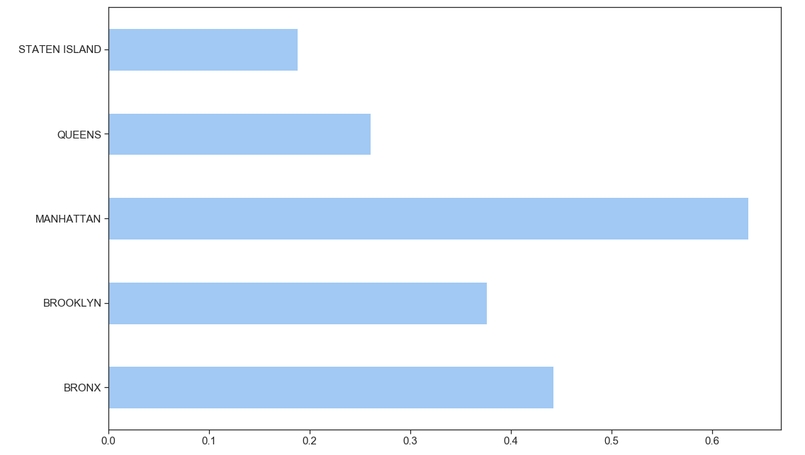
Where is Noisy
Total
Per Person

Slide 12
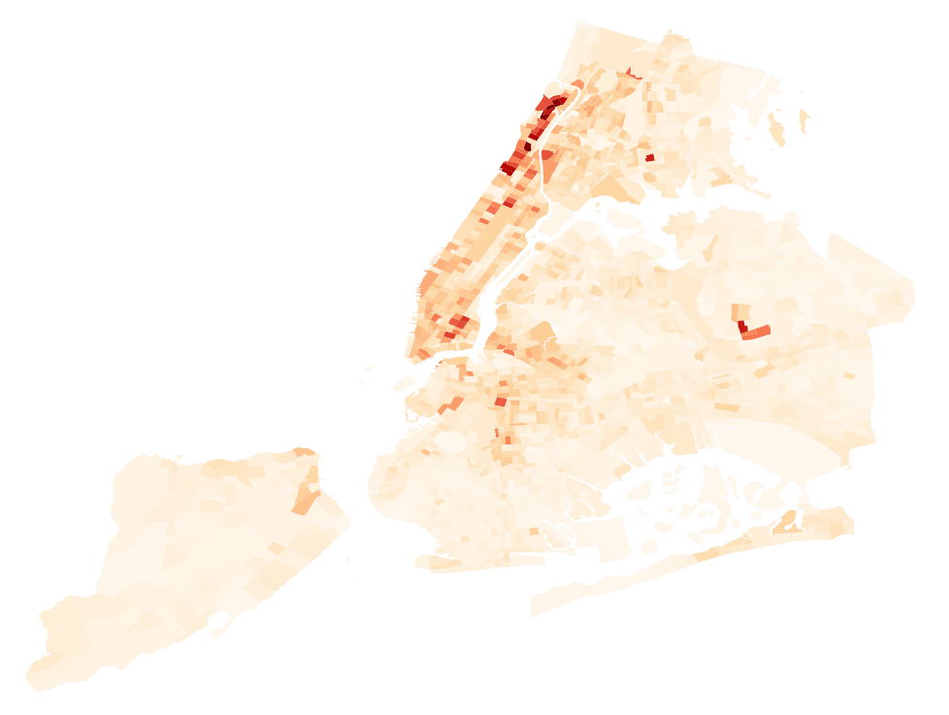
It’s a Noise or Income issue
https://www.businessinsider.com/new-york-city-income-maps-2014-12

Slide 13
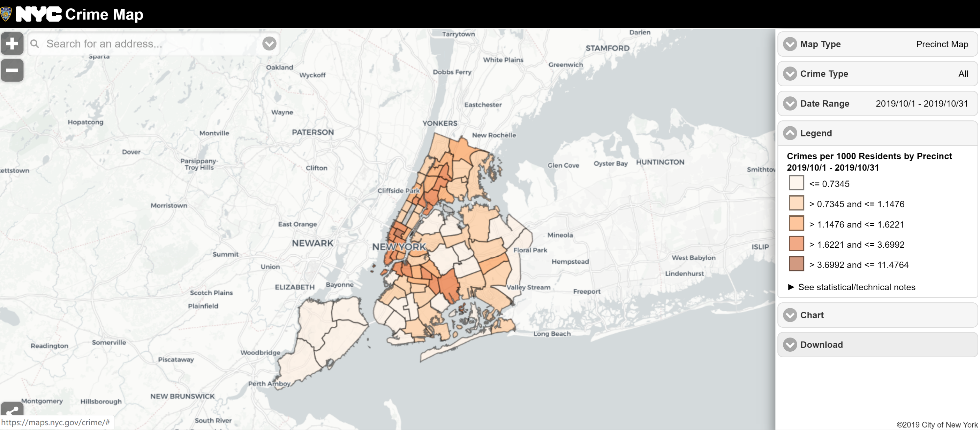
It’s a Noise or Income issue
https://maps.nyc.gov/crime/

Slide 14
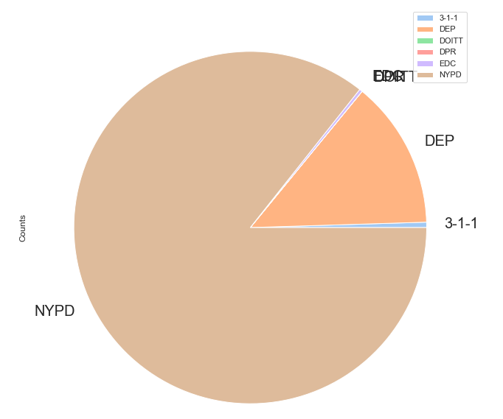
Who Report Noise

Slide 15
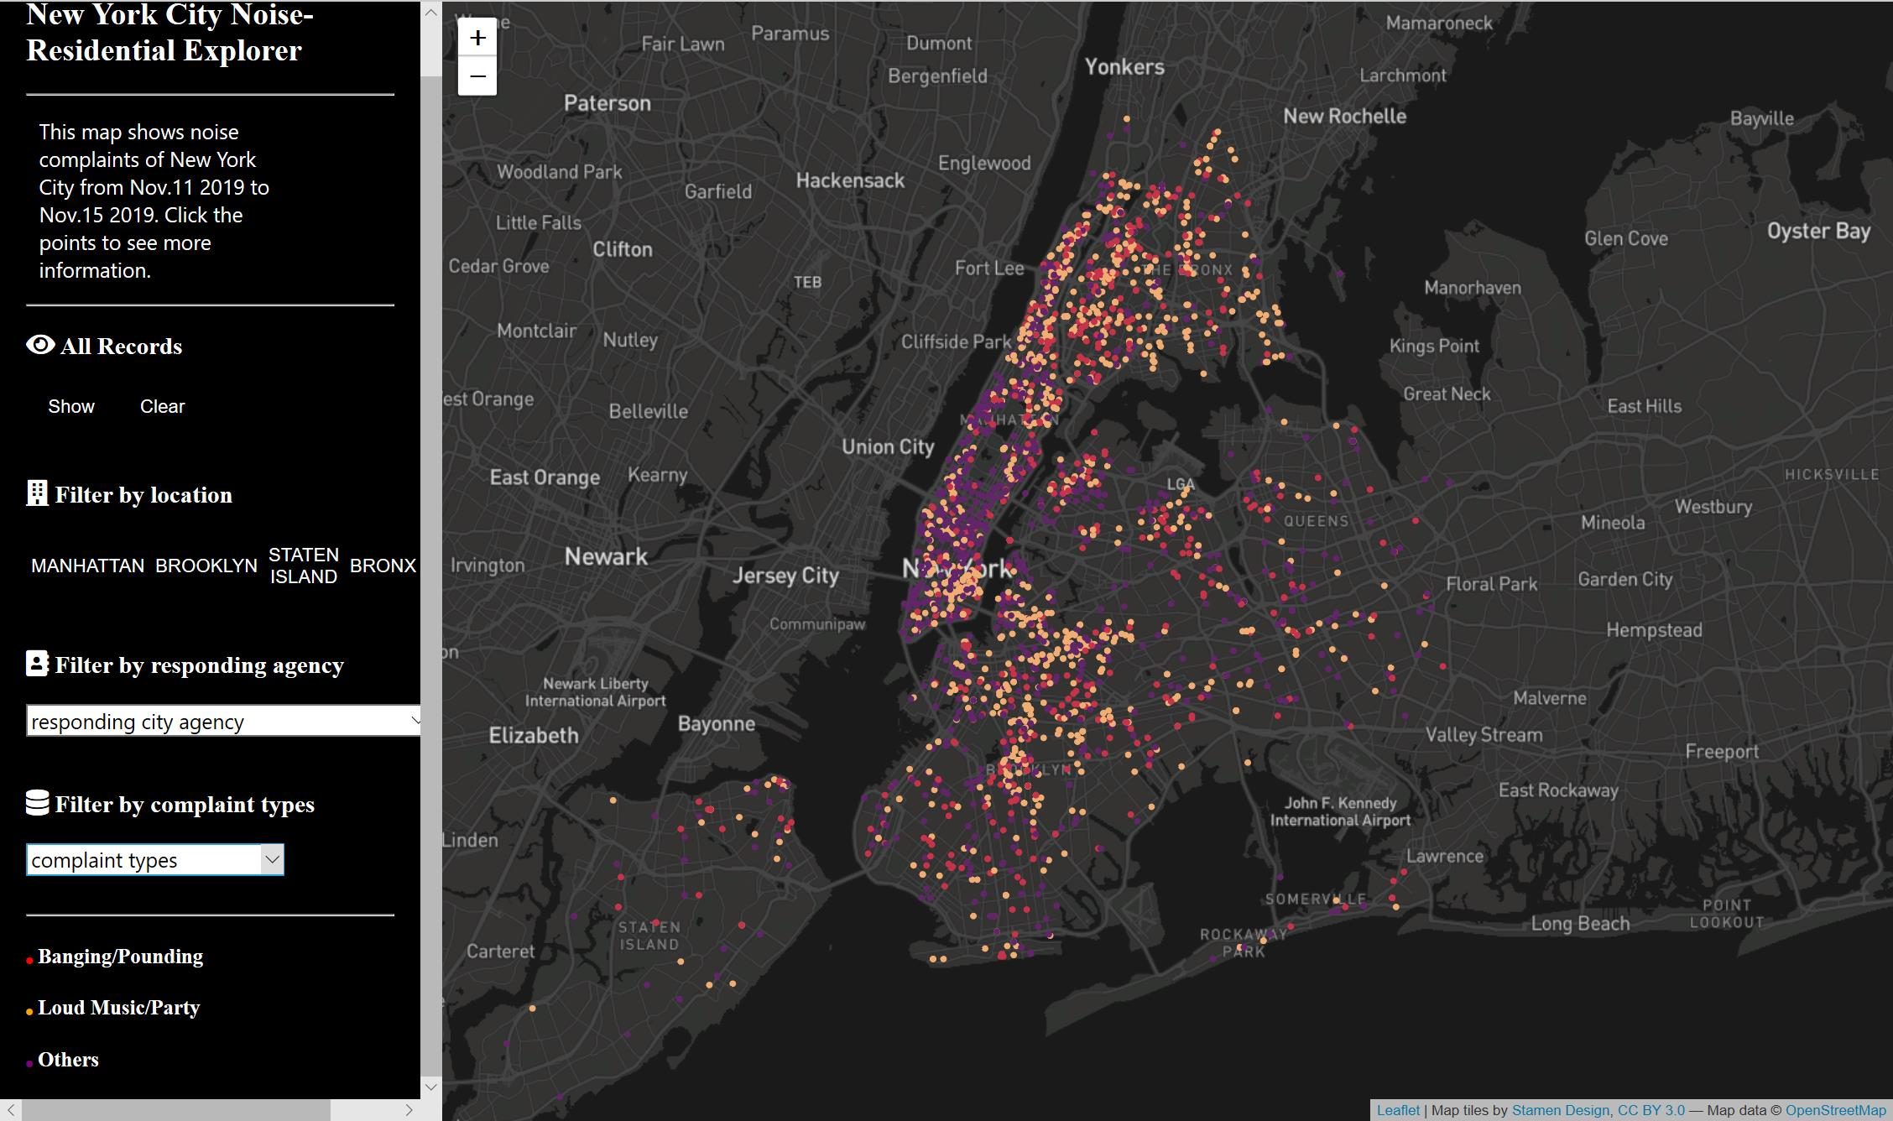
https://joy9615.github.io/

